Slide 1
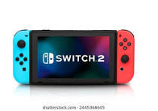

Nintendo Switch

Slide 2
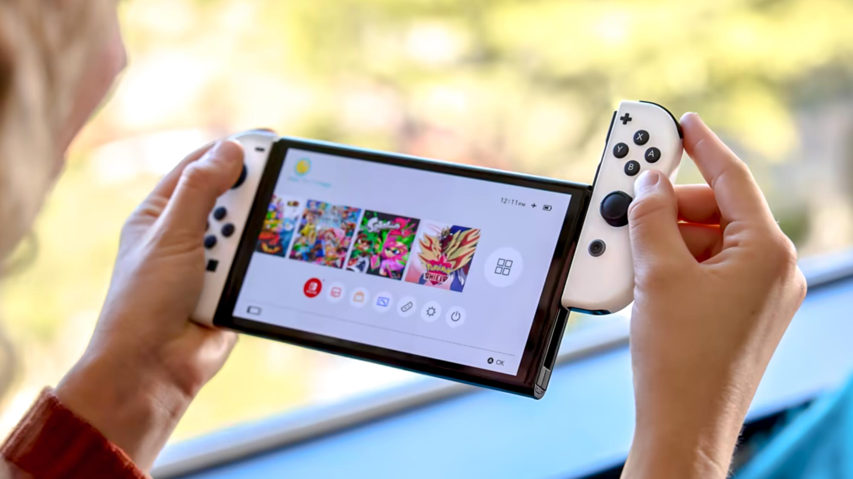
Key features
The Controllers are detachable
4
3
It’s portable
3
2
It can be connected to your tv
5
1
It has many games
Company Name
Quarter Month
Year

Slide 3
What sets us apart?
Portable
Small and easy to learn
Has youtube so you can watch some videos

Slide 4
Revenue Growth
(2022–2025)
$3.8 Billion
$11.536 Billion
$13.923 Billion
How did nintendo lose their revenue
$12.63 Billion
2022
2023
2024
2025
Have you noticed that the revenue dropped by a whopping 8.83 billion from the year 2022
Nintendo experienced a decline in revenue during the year ending March 2025.

Slide 5
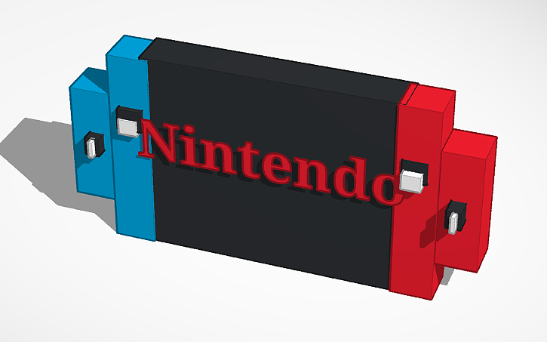
This is our tinker model

Slide 6
Price:299.99

Slide 7

Marketing Strategies
Ads
Billboards
Posters

Slide 8
Why you should choose us
It is way cheaper than a phone or laptop so you should get the nintendo switch
It has a touchscreen unlike other devices
It has a 30 day return policy and if you have a membership you get a 2 month return policy

Slide 9

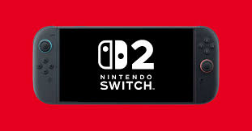

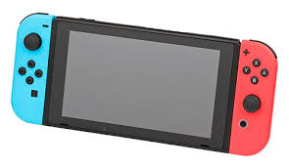
Types of Nintendo Switches
Nintendo Switch 2
Nintendo Switch lite
Nintendo Switch oled
Nintendo Switch 1

Slide 10
How much we want and how much percentage
We want $300K for 25%

Slide 11





Thank You!

